Slide 1

STAT4830: Numerical Optimization for Data Science and Machine Learning
Optimization in Preference Learning:
A Utility-based Probability Prediction Method Used in Hotel Booking Dataset
Shuhan Zhang zhang19@sas.upenn.edu
Xinyu Zhang joyxyz@sas.upenn.edu
Lexuan Chen amy0305@sas.upenn.edu

Slide 2
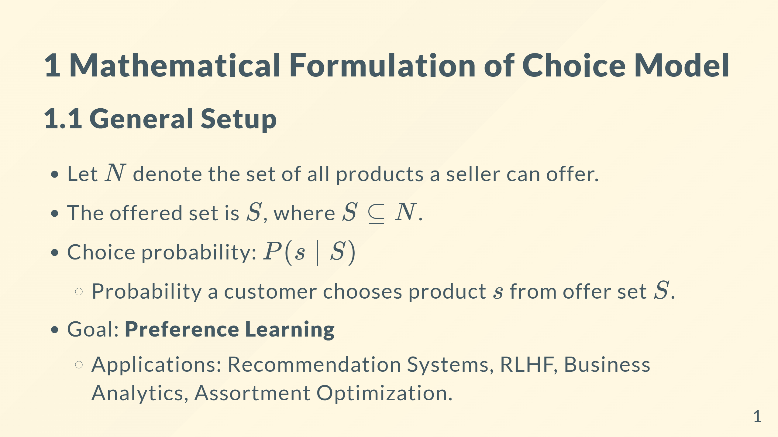

Slide 3
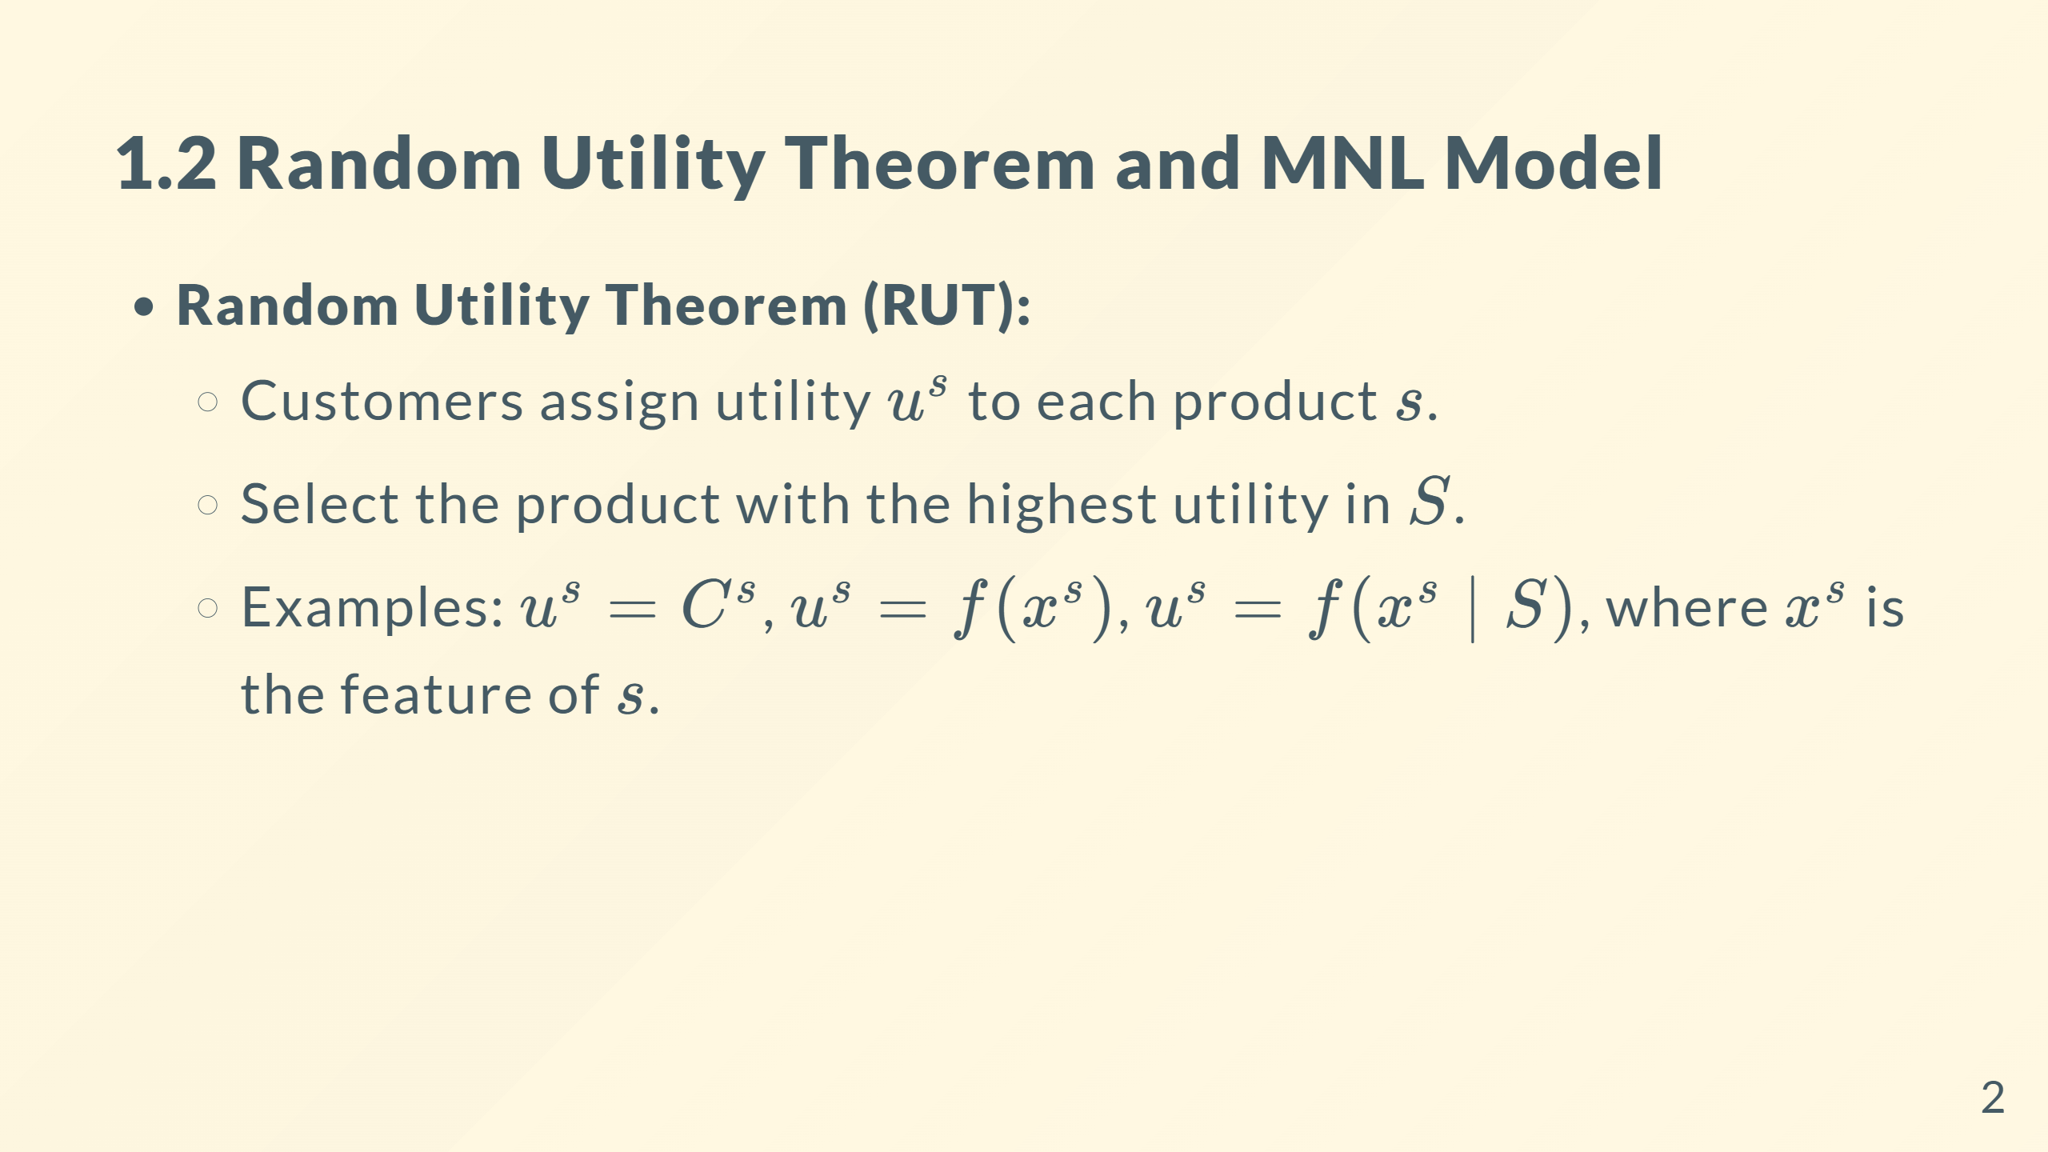

Slide 4
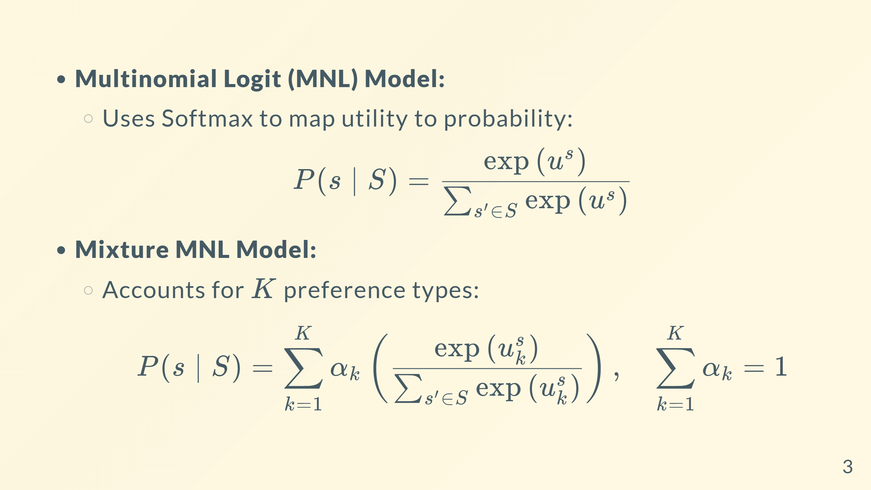

Slide 5
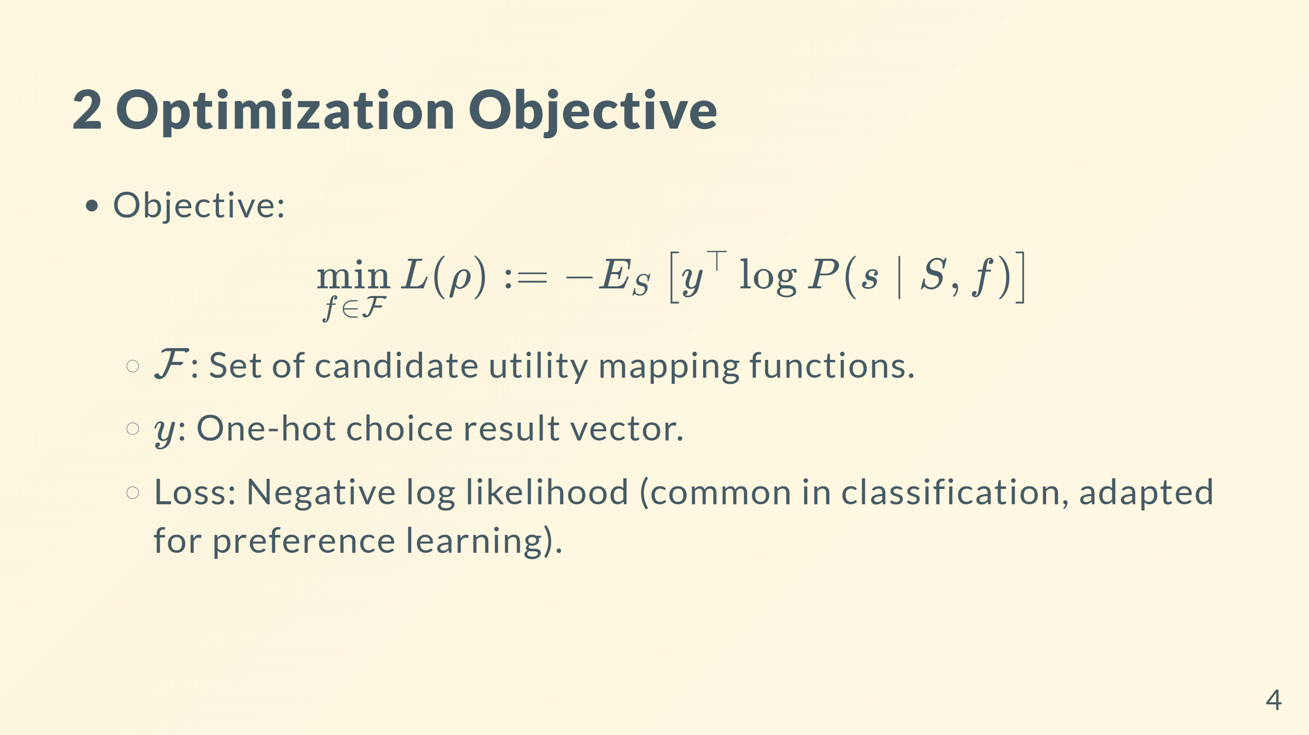

Slide 6
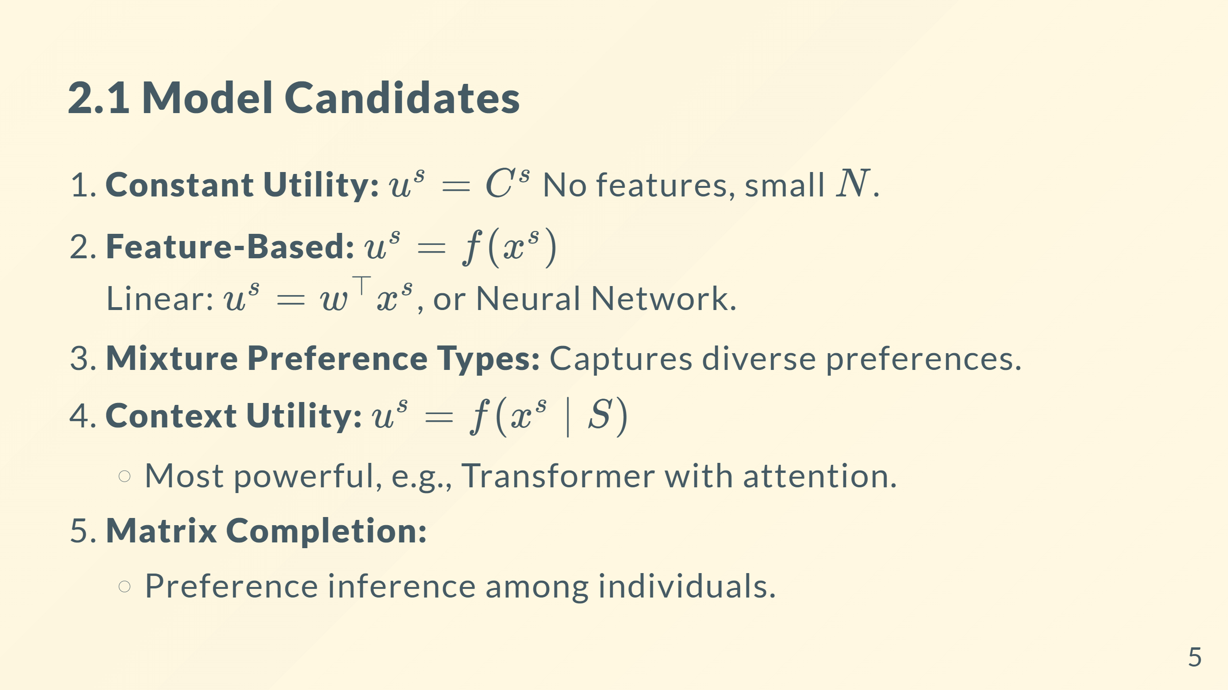

Slide 7
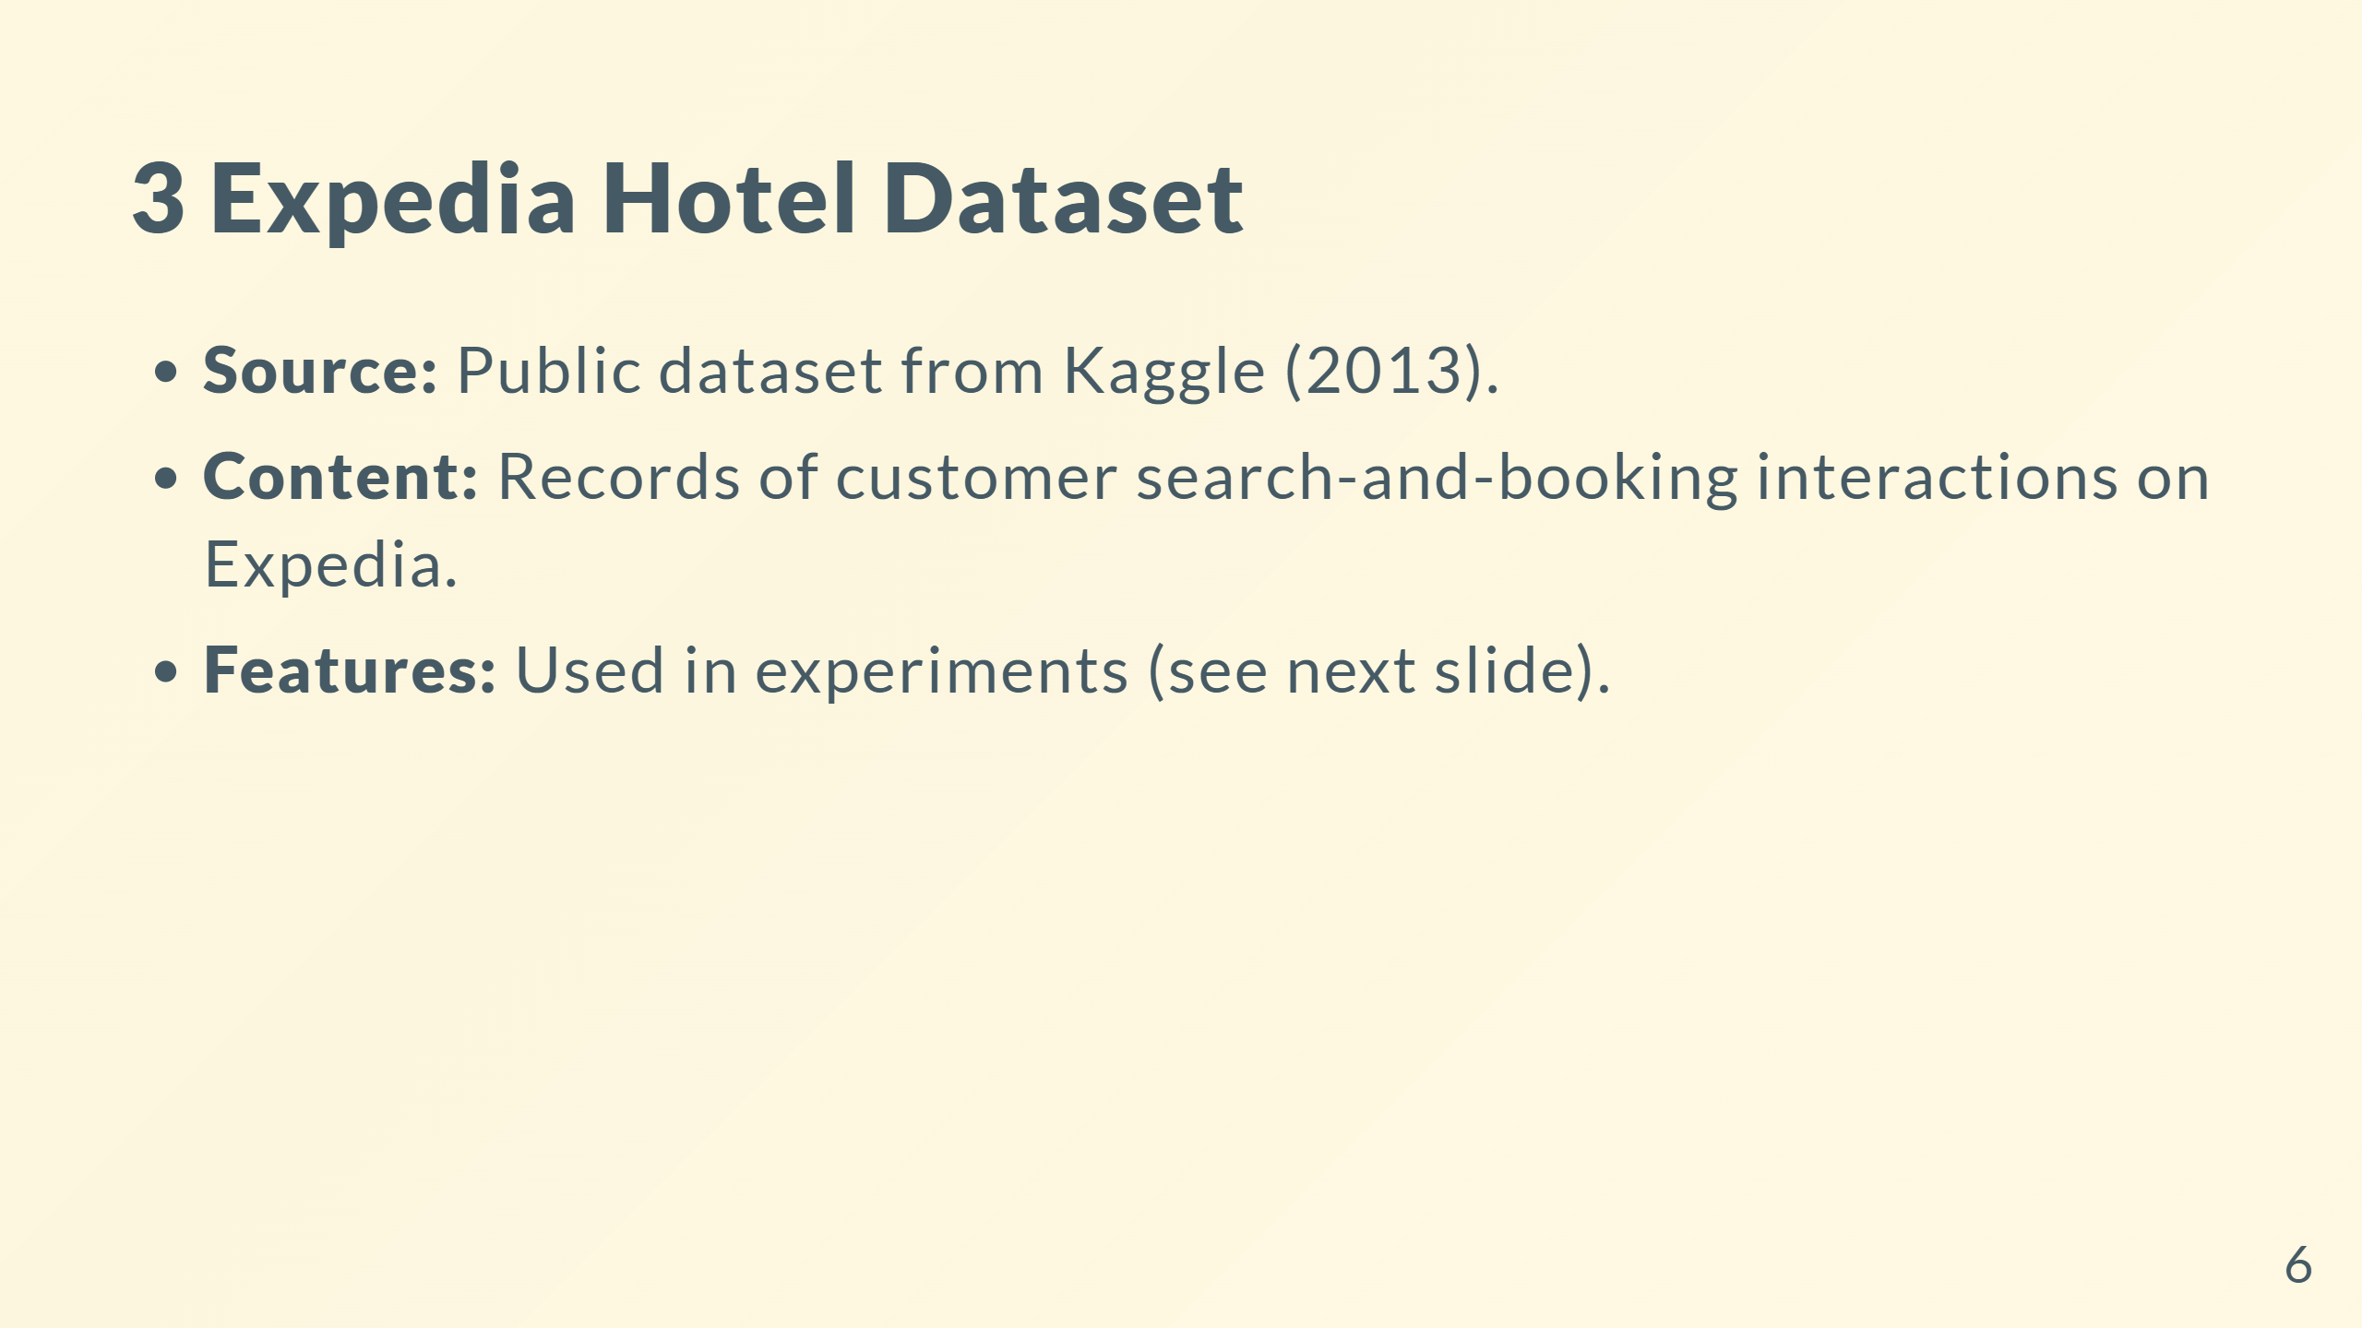


Slide 8
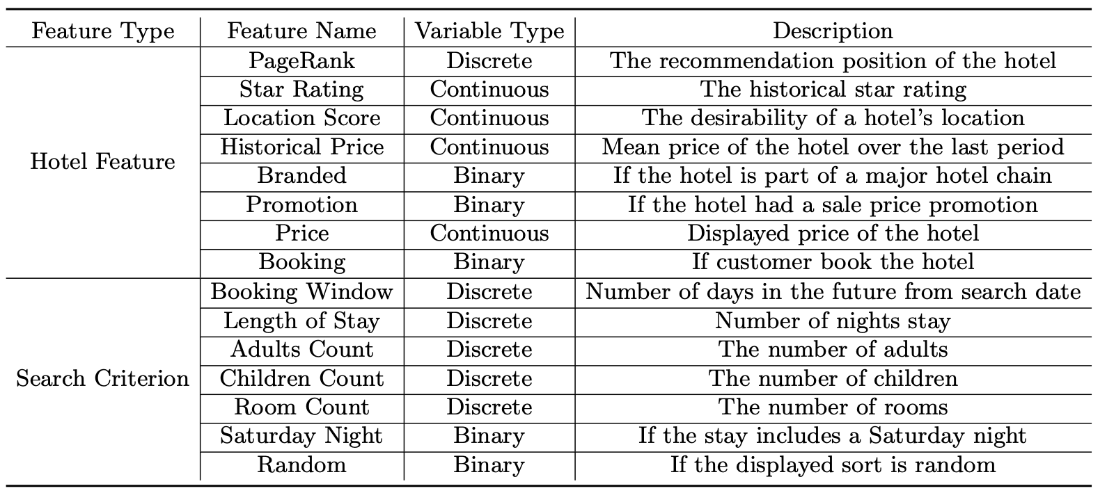
Feature Introduction: Expedia Hotel Dataset
7

Slide 9
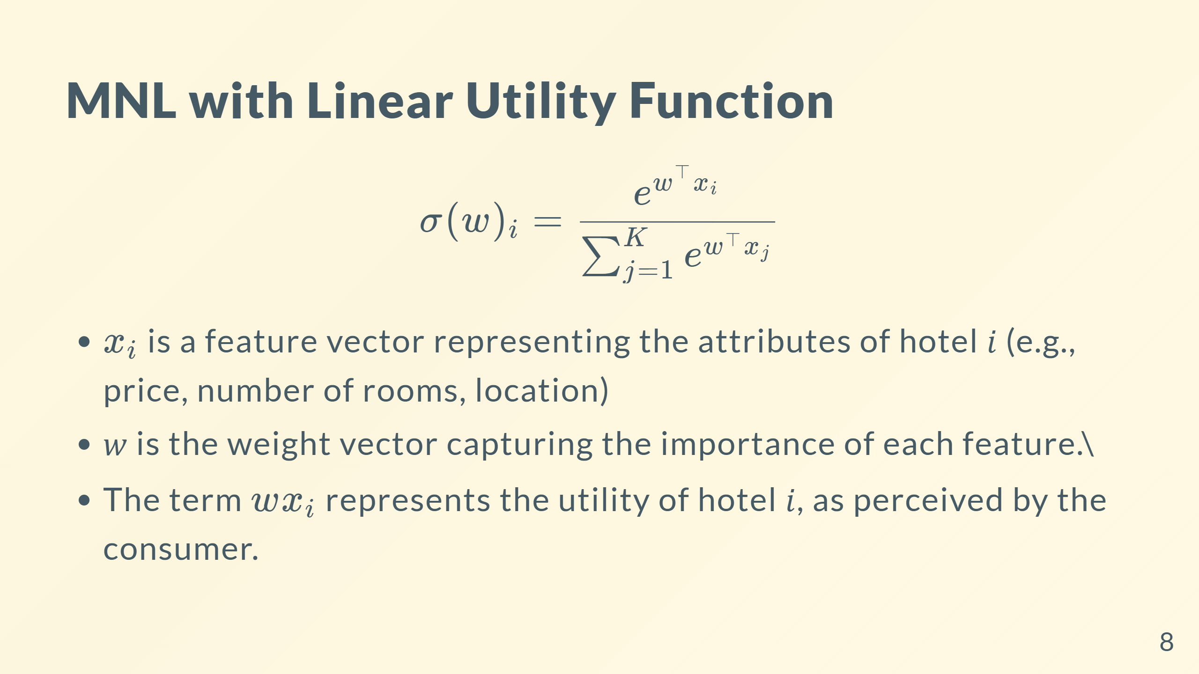



Slide 10
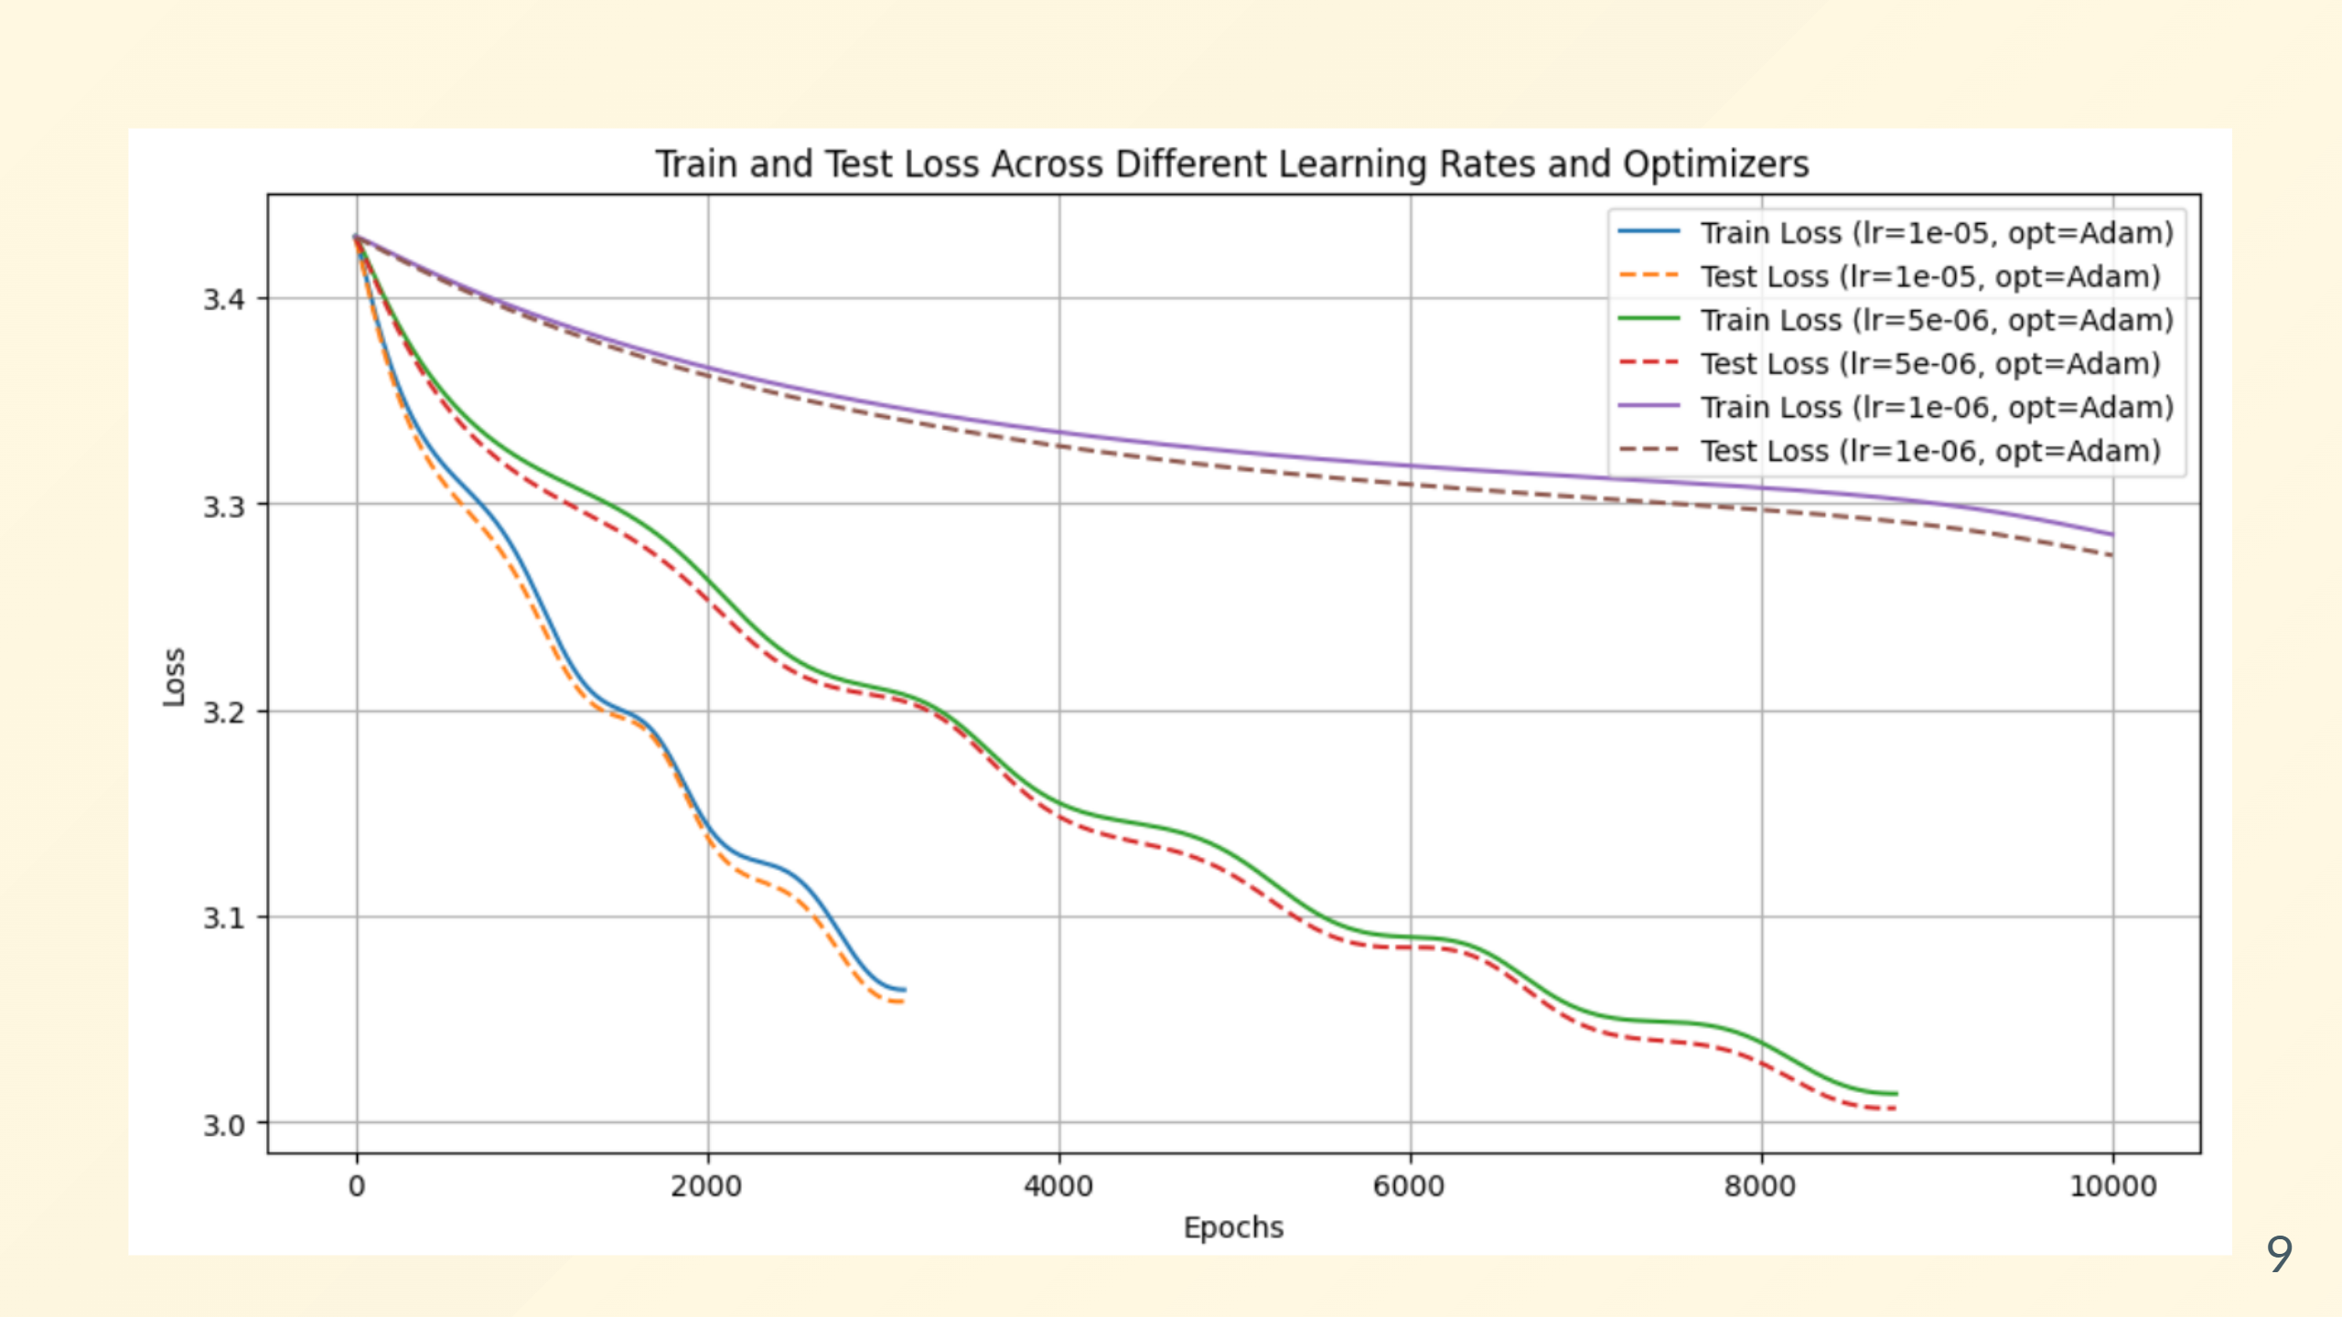
Linear Utility Function NLL Loss

Slide 11
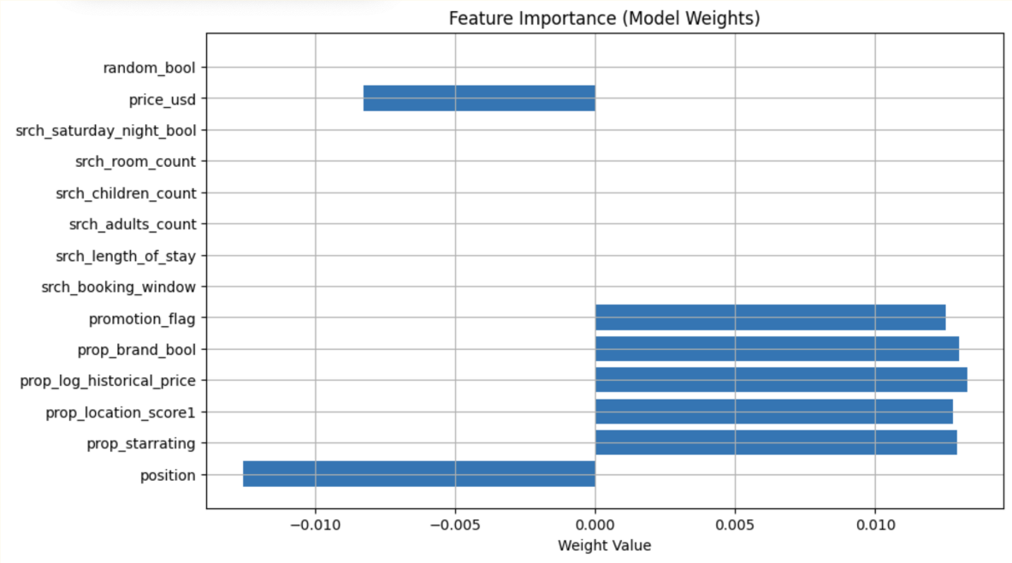
Consumer Feature
Item Feature
10

Slide 12
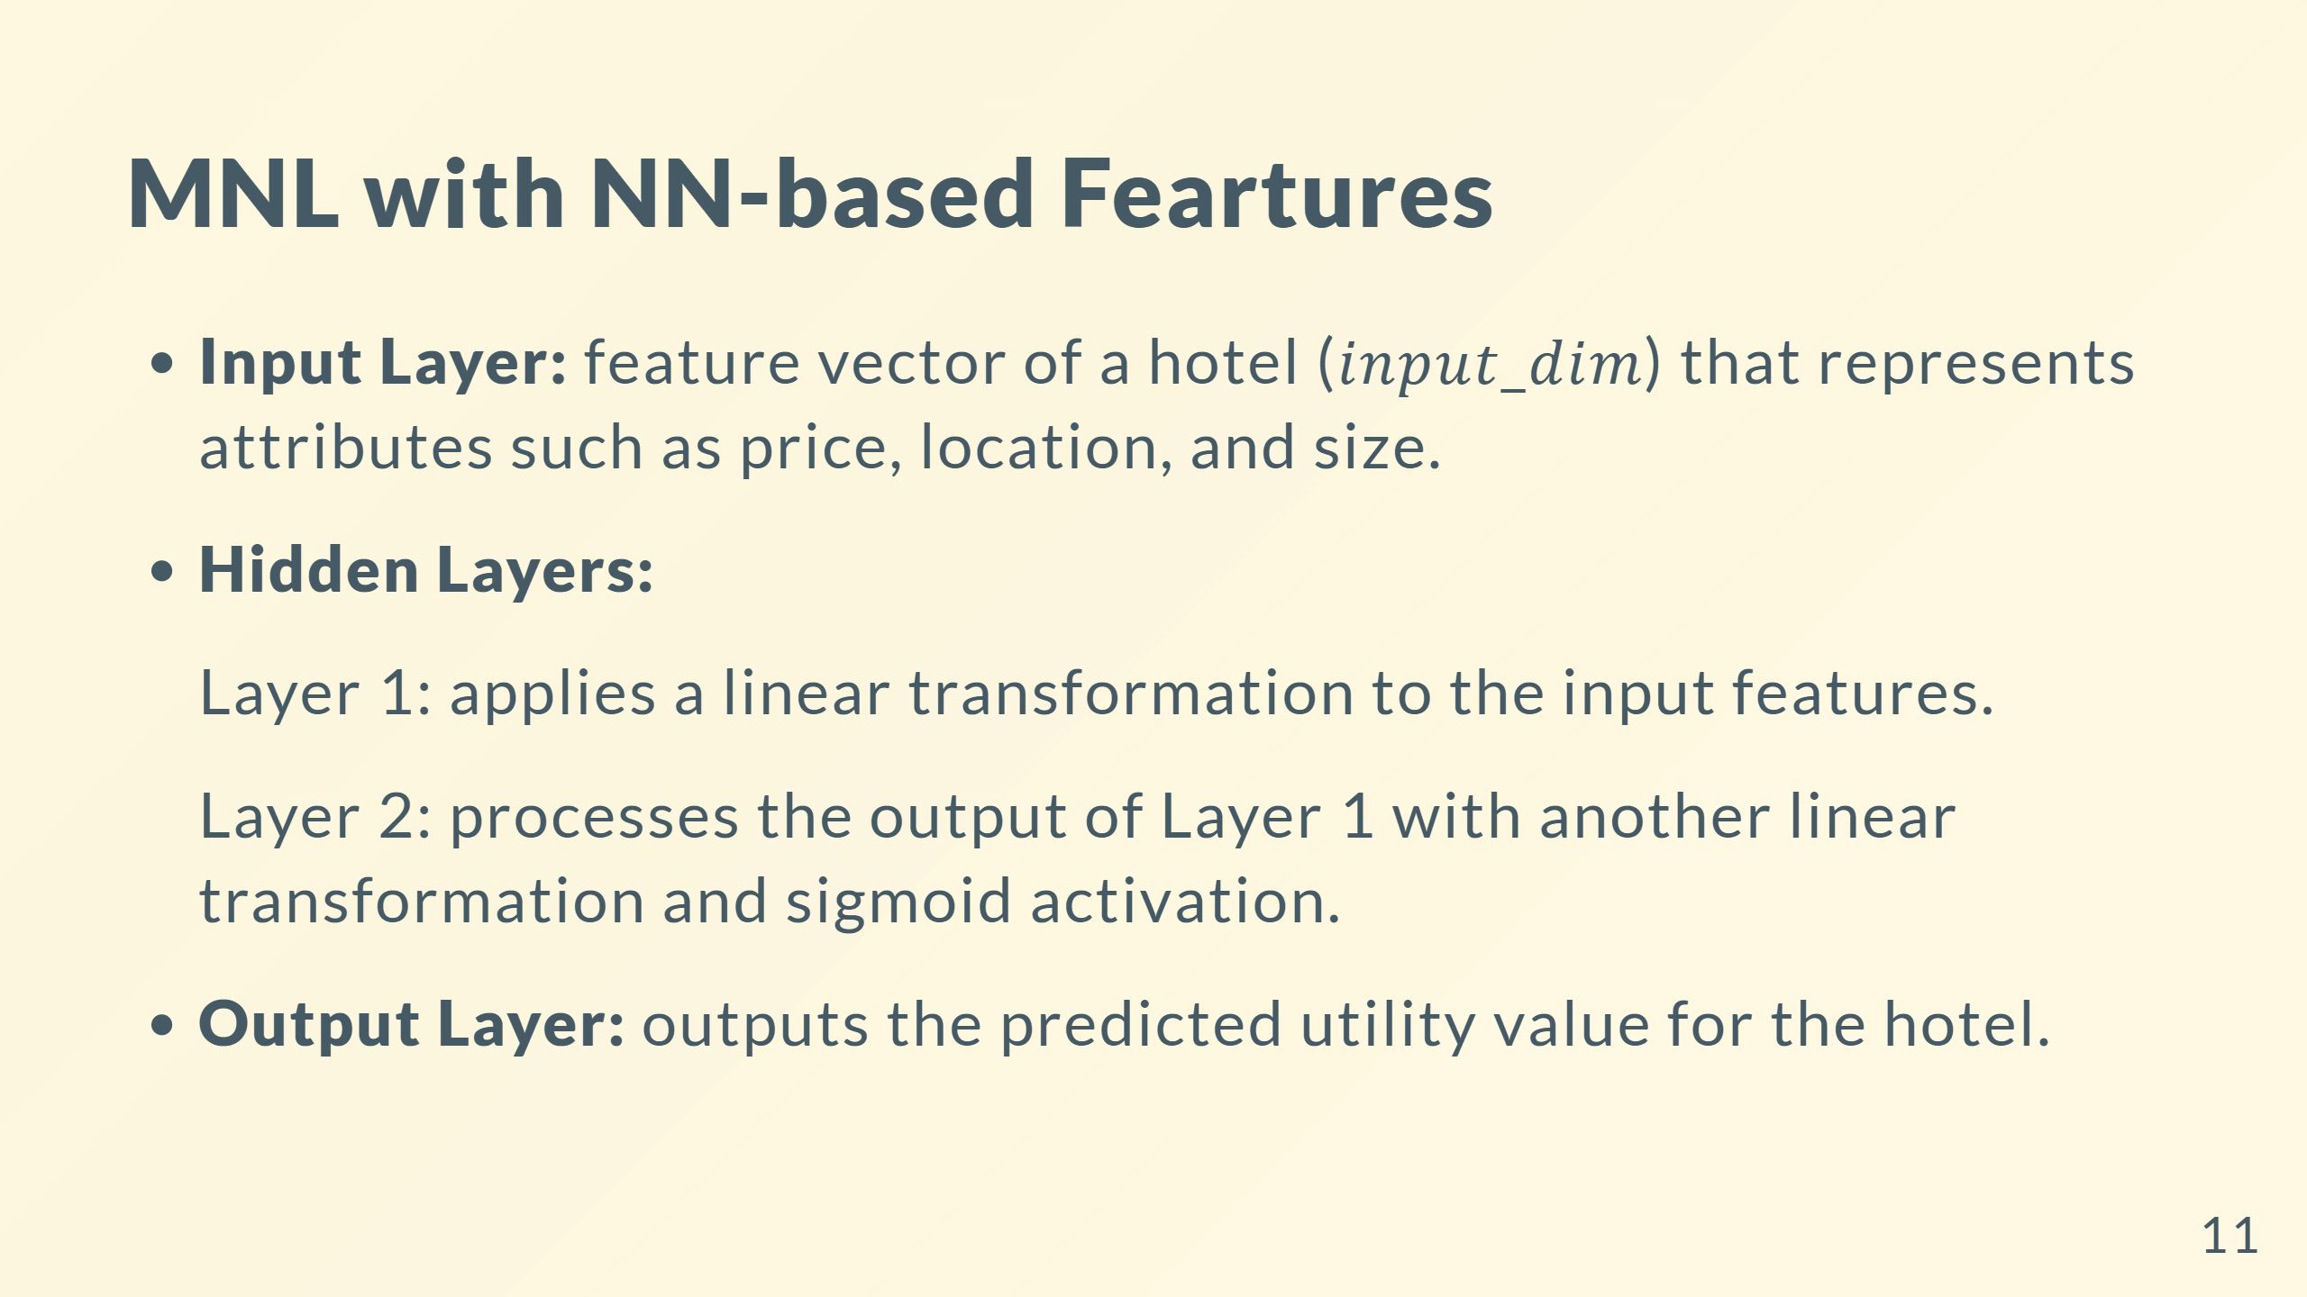

Slide 13
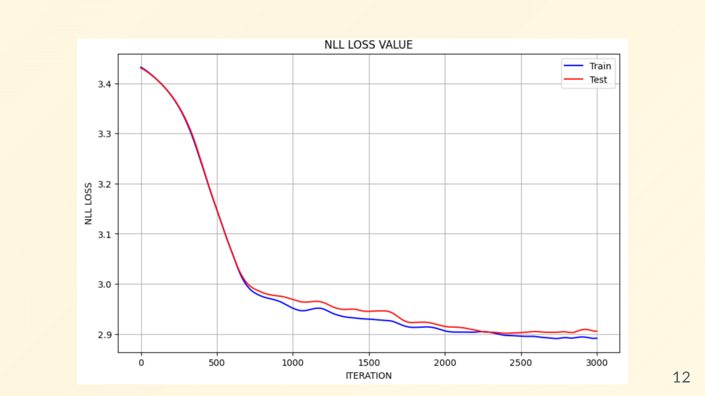
Neural Network NLL Loss

Slide 14
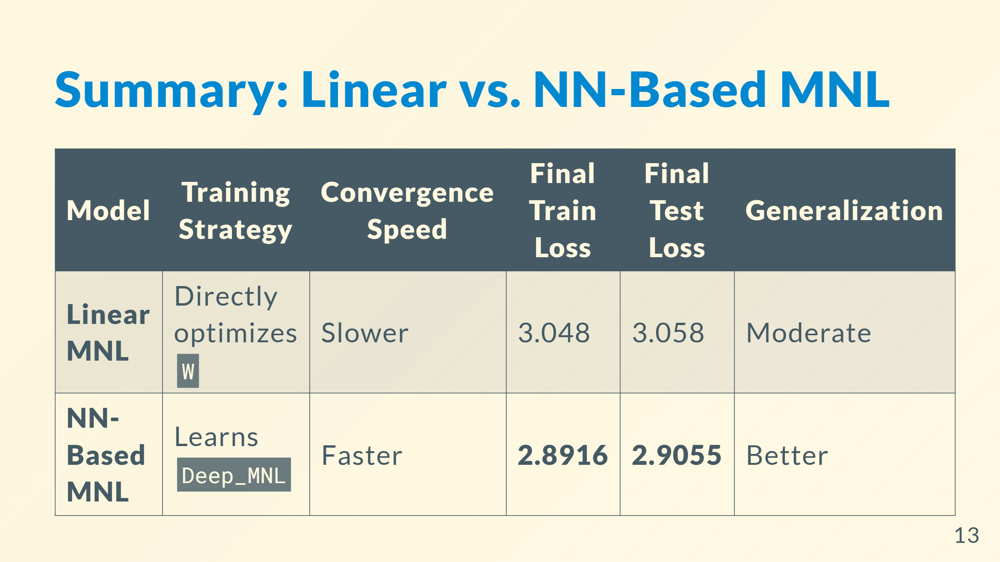

Summary: Linear vs. NN-Based MNL

Slide 15

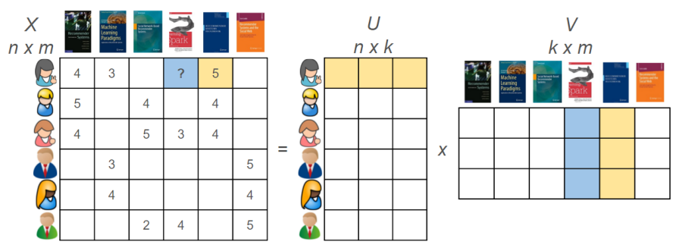
Matrix Completion
Netflix Dataset
(Film Puzzle)
Expedia Dataset
(Hotel Puzzle)
Rating Matrix
User Matrix
Item Matrix
• Both Recommendation Systems
• Not every user rates every item, leading to a sparse user–item interaction matrix
• Predicting missing entries
✅
First matrix ---- each row belongs to an individual
Second matrix ---- each column belongs to an item
Both express the power of association between a user or an item with latent factors or hidden features.
A
1
 | 1
 |  | 1
1
 |  |  | 1
 | 1
Data Combination
Multiple Clustering
Item features
Consumer types
Consumers in same clustered group have similar preferences and utility distribution
B
C
B
1/2 | 1/2
 | 1/3 | 1/3 | 1/3
B
C
Basic Algorithm
SVT
C
C
FPC (Fixed Point Continuation)
14

Slide 16
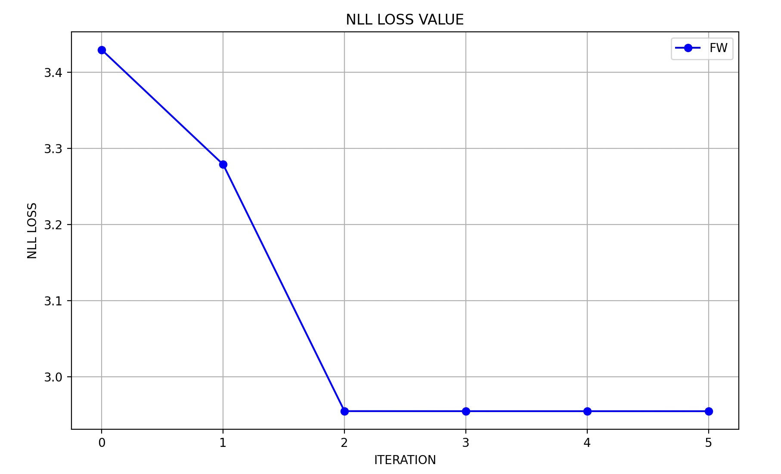
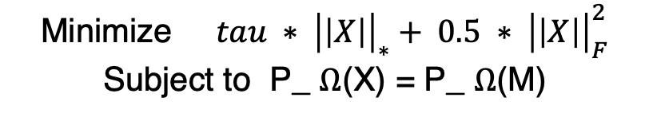
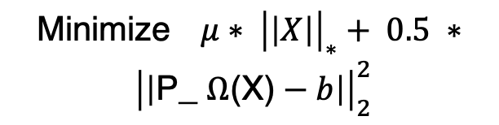
Next Steps
Mixture Consumer Types
Context Based Utility
Transformer with attention
Mutual influences within items
Algorithm constraints
Singular Value Thresholding (SVT) method
Fixed Point Continuation (FPC) method
Minimize$tau ∗ {\left|\left|X\right|\right|}_{∗}+ 0.5 ∗ {\left|\left|X\right|\right|}_{F}^{2}$
Subject to P_ $Ω$(X) = P_ $Ω$(M)
Minimize$μ∗ {\left|\left|X\right|\right|}_{∗}+ 0.5 ∗ {\left|\left|\text{P}\text{_} Ω\text{(}\text{X}\text{)}−b\right|\right|}_{2}^{2}$
15

Slide 17
☺️ Thanks for Listening!

